Slide 1
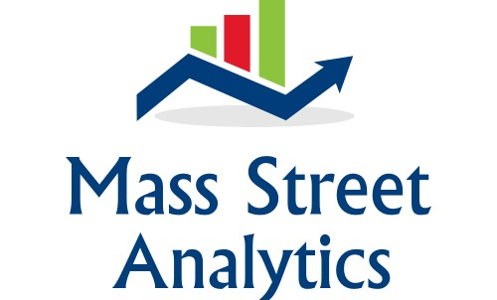
Hands On: Introduction to the Hadoop Ecosystem
Bob Wakefield
Principal
bob@MassStreet.net
Twitter: @BobLovesData

Slide 2
Who is Mass Street?
Boutique data consultancy
We work on data problems big or “small”
We have a focus on helping organizations move from a batch to a real time paradigm.
Free Big Data training

Slide 3
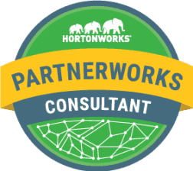


Mass Street Partnerships and Capability
Hortonworks Partner
Confluent Partner
ARG Back Office

Slide 4
Bob’s Background
IT professional 16 years
Currently working as a Data Engineer
Education
BS Business Admin (MIS) from KState
MBA (finance concentration) from KU
Coursework in Mathematics at Washburn
Graduate certificate Data Science from Rockhurst
Addicted to everything data

Slide 5
Follow Me!
Personal Twitter: @BobLovesData
Company Twitter: @MassStreet
Blog: DataDrivenPerspectives.com
Website: www.MassStreet.net
Facebook: @MassStreetAnalyticsLLC

Slide 6
KC Learn Big Data Objectives
Educate people about what you can do with all the new technology surrounding data.
Grow the big data career field.
Teach skills not products

Slide 7
ACM Kansas City
We’re looking for a speaker willing to talk in deep detail about data engineering challenges their organization is experiencing.

Slide 8
This Evening’s Learning Objectives
Tonight we’ll cover the following topics
Tidyverse
Reproducible Research
Literate Statistical Programming
Opinionated Analysis
Data Science as a Science
We’ll also cover the following tools
Git
Jupyter Notebook
Knitr/Rmarkdown, Markdown
S3
SparklyR

Slide 9
All Material Can Be Downloaded from GitHub
MassStreetAnalytics/Reproducible-Research

Slide 10
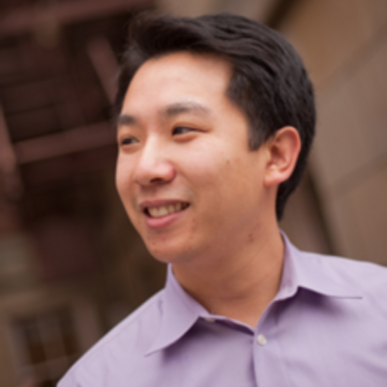
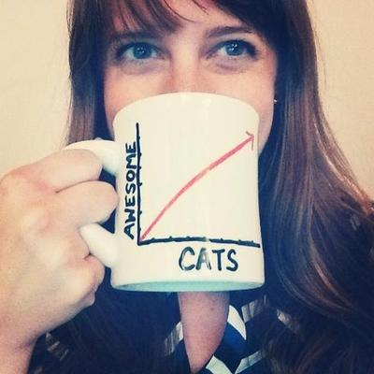
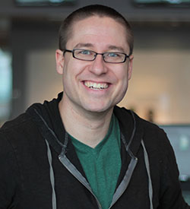

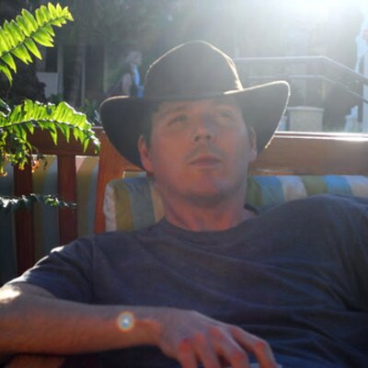
It’s All Six Degrees of Johns Hopkins’ Biostatistics Department
People Associated With
Johns Hopkins
People NOT Associated
With Johns Hopkins
Not So Standard
Deviations Podcast
Tidyverse
Reproducible Research
Literate Statistical Programming
Opinionated Analysis
Data Science as a Science
Roger Peng
Hillary Parker
Jeff Leek
Simply Statistics
Website
Hadley Wickham
Brian Caffo

Slide 11
Motivations For This Evenings Discussion
My investment application is moving into a new phase of work.
I don’t have a PhD. (sad face)
My need to smack down trolls on FB.
Demand more from the internet.
Showing your work should be the new standard

Slide 12
Changes to the Career Field in the Past 15 Months
Rise of Python for Data Science/Engineering
Rise of notebooks (Jupyter, Zeppelin, R Notebook)
Data Science SaaS (cloud, cloud, and more cloud)
R got a nice NLP package
Deep Learn all the things!
Rise of Spark.

Slide 13
Reproducible Research
Introduction to the topic came from the Not So Standard Deviations Podcast.
Researches and software engineers approach data science wildly differently.
Both sides can learn from the other.

Slide 14
Reproducible Research
Someone should be able to run your exact analysis and get your result.
Goal is to reproduce NOT replicate.
Reproduce = validate your work
Replicate = validate the conclusions of the study
This is a lot harder than it sounds.
Reproducibility hasn’t been totally figured out.
I still struggle with dependencies
Build tools for R?

Slide 15
Reproducible Research
Someone should be able to run your exact analysis and get your result.
Goal is to reproduce NOT replicate.
Reproduce = validate your work
Replicate = validate the conclusions of the study
This is a lot harder than it sounds.
Reproducibility hasn’t been totally figured out.

Slide 16
Reproducible Research
Elements of reproducibility
Analytic data (the Tidy data)
Analytic code
Documentation
Distribution
Of these, distribution is the trickiest

Slide 17
Reproducible Research
Literate Statistical Programming
Combine your analysis and your code into a single document
There are several tools for this
Markdown
RMarkdown/knitr
R Studio
Notebooks

Slide 18
Reproducible Research
A proposed structure of analysis*
Defining the question
Defining the ideal dataset
Determining what data you can access
Obtaining the data
Cleaning the data
Exploratory data analysis
Statistical prediction/modeling
Interpretation/Challenging of results
Synthesis and write up
Creating reproducible code
*From “Report Writing for Data Science in R”

Slide 19
Reproducible Research
Reproducibility Checklist*
Start with good science
Don’t do things by hand
Don’t point and click
Teach a computer
Use version control
Keep track of your software environment
Don’t save output
Set your seed
Think about the entire pipeline
*From “Report Writing for Data Science in R”

Slide 20
Opinionated Analysis Development
Read Opinionated Analysis Development
Link in references
Opinionated analysis = analysis that follows certain practices
Follows on to the principals of reproducible research
Lays out a framework for how an analysis should be completed

Slide 21
Reproducible Research
Reproducibility Checklist*
Start with good science
Don’t do things by hand
Don’t point and click
Teach a computer
Use version control
Keep track of your software environment
Don’t save output
Set your seed
Think about the entire pipeline
*From “Report Writing for Data Science in R”

Slide 22
Tidy Data
Three rules that make data tidy:
Each variable must have its own column.
Each observation must have its own row.
Each value must have its own cell.
No you’re not crazy. Yes that’s third normal form.
I don’t have to deal with this issue often if ever.

Slide 23
Tidyverse
Used to be called the Hadleyverse
An ecosystem of packages designed with common APIs and a shared philosophy
Helps you get your data tidy
Also assumes that your data is tidy

Slide 24
Part II: Tools
Git
Modern Source Control
Code repositories: GitHub and Bitbucket
GUI: Sourcetree
Rmarkdown/knitr
Appears to be strictly an R Studio thing
Pandoc Markdown/Jupyter
Julia, Python, R
Rebranded Ipython

Slide 25
Part II: Tools
SparklyR/Databricks
SparklyR provides an R API for Spark with dplyr
AWS/S3
Helps solve the problem of accessibility to data
Can be annoying to manage
Tidyverse
A set of packages that makes working with data easier

